Slide 1

Bank Churn Prediction
By: Sai Srikar Gandhe
Fhariya Aseem Fathima

Slide 2
Outline
Introduction
Problem Statement
Approach/Pipeline
Data Set Description
EDA
About the models
Results
References

Slide 3
Introduction
The banking business has gotten increasingly competitive in recent years, and customer churn has become a serious concern. .
Customers can simply transfer banks, making it critical for banks to identify the causes of churn and implement effective retention strategies .

Slide 4
Problem Statement
The challenge is to develop a model that accurately predicts the customer churn out.
This project is to investigate the factors that contribute to bank customer churn and to develop an accurate predictive model and compare those models.
The best-performing model can be achieved by comparing accuracies.

Slide 5
Approach/ Pipeline
Data Extraction
Exploratory Data Analysis
Feature Selection
Data Preprocessing
Model Training
Model Evaluation

Slide 6
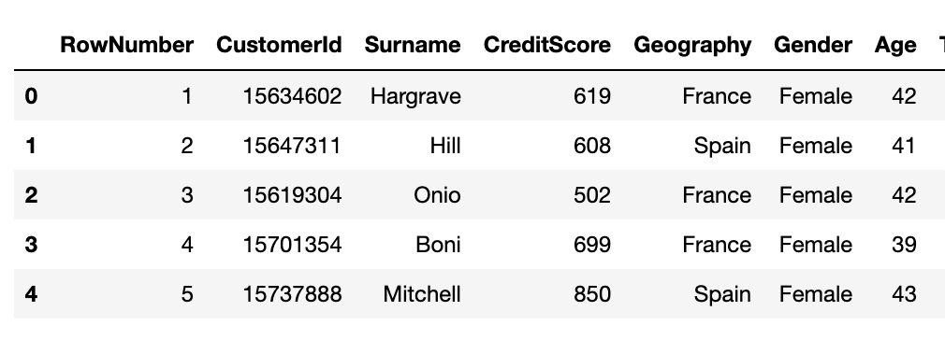
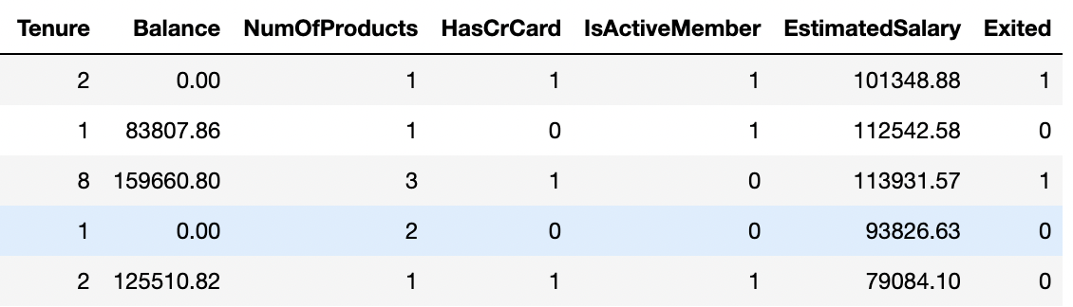
Data Set Description
This data set comprises information about bank customers, and the target variable is a binary variable that indicates whether the customer has left the bank (closed his account) or not .

Slide 7
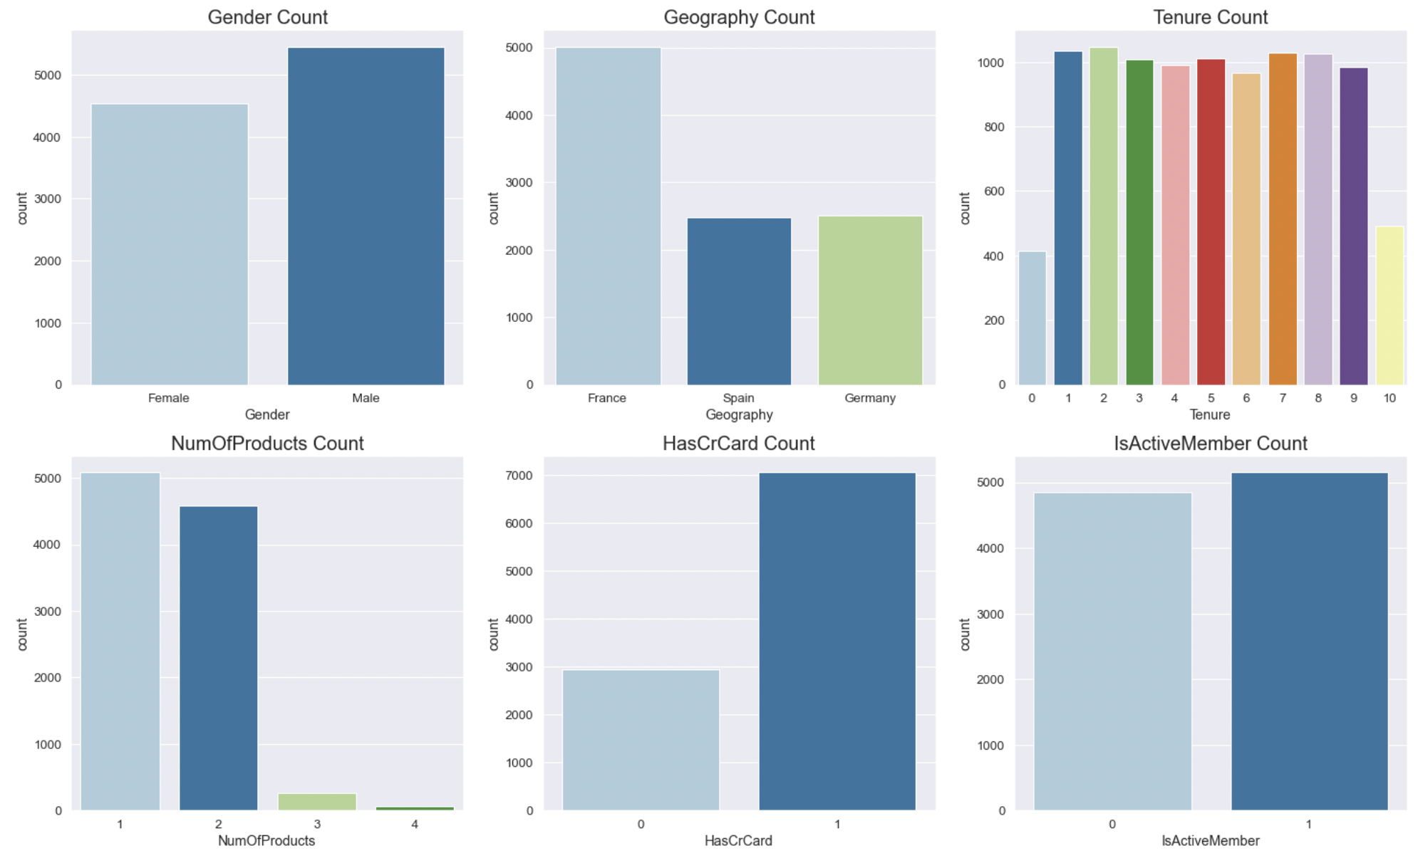
EDA
1
Visualizing categorical variables.
More than 50% customers are male in this data set.
Most of the customers in this data are in the bank between 1-9 years.
Most of the customers are from France.

Slide 8
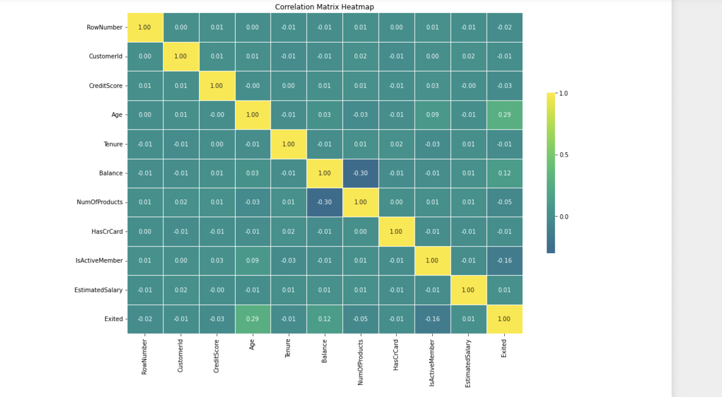
EDA
Heatmaps are frequently used to represent the relationship between different variables in a dataset. I have used three different cmaps.
1) Viridis
2) Plasma
3) Magma
Fig: Viridis

Slide 9
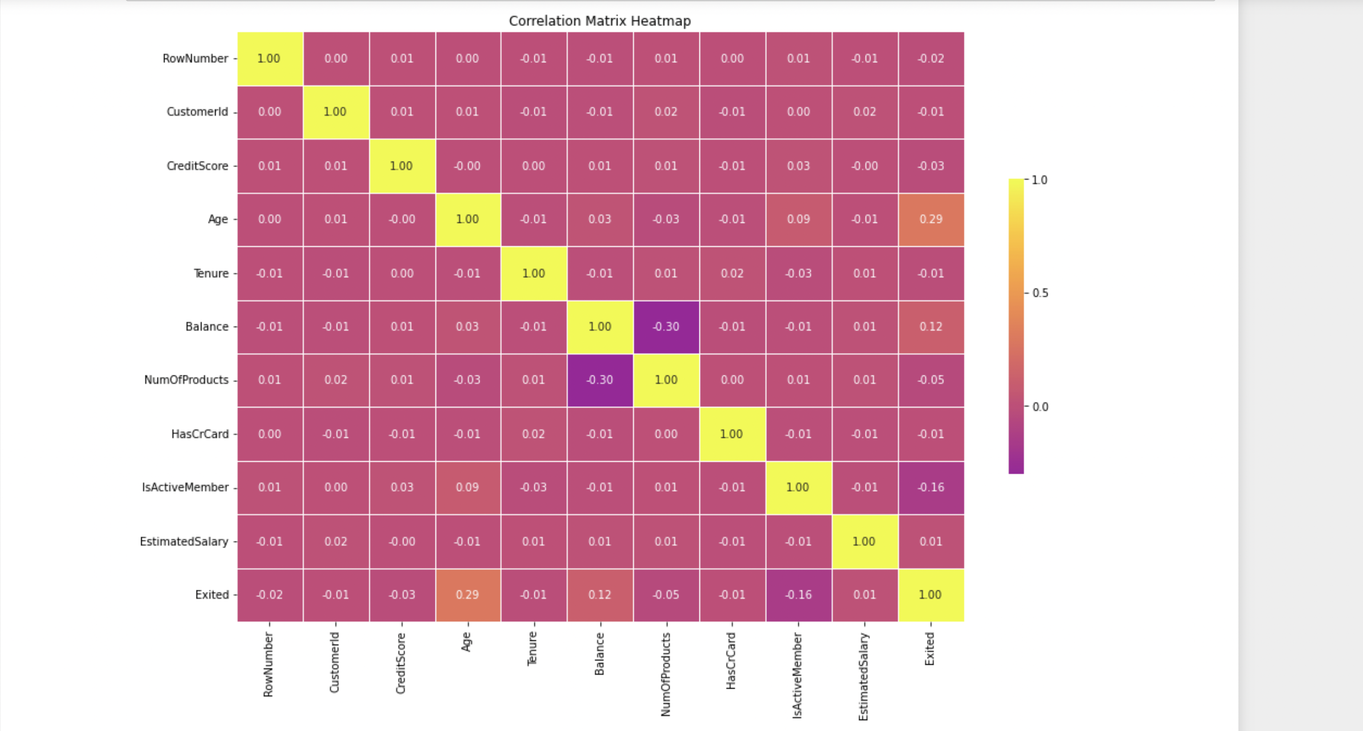
EDA
Heatmaps are frequently used to represent the relationship between different variables in a dataset. I have used three different cmaps.
1) Viridis
2) Plasma
3) Magma
Fig: Plasma

Slide 10
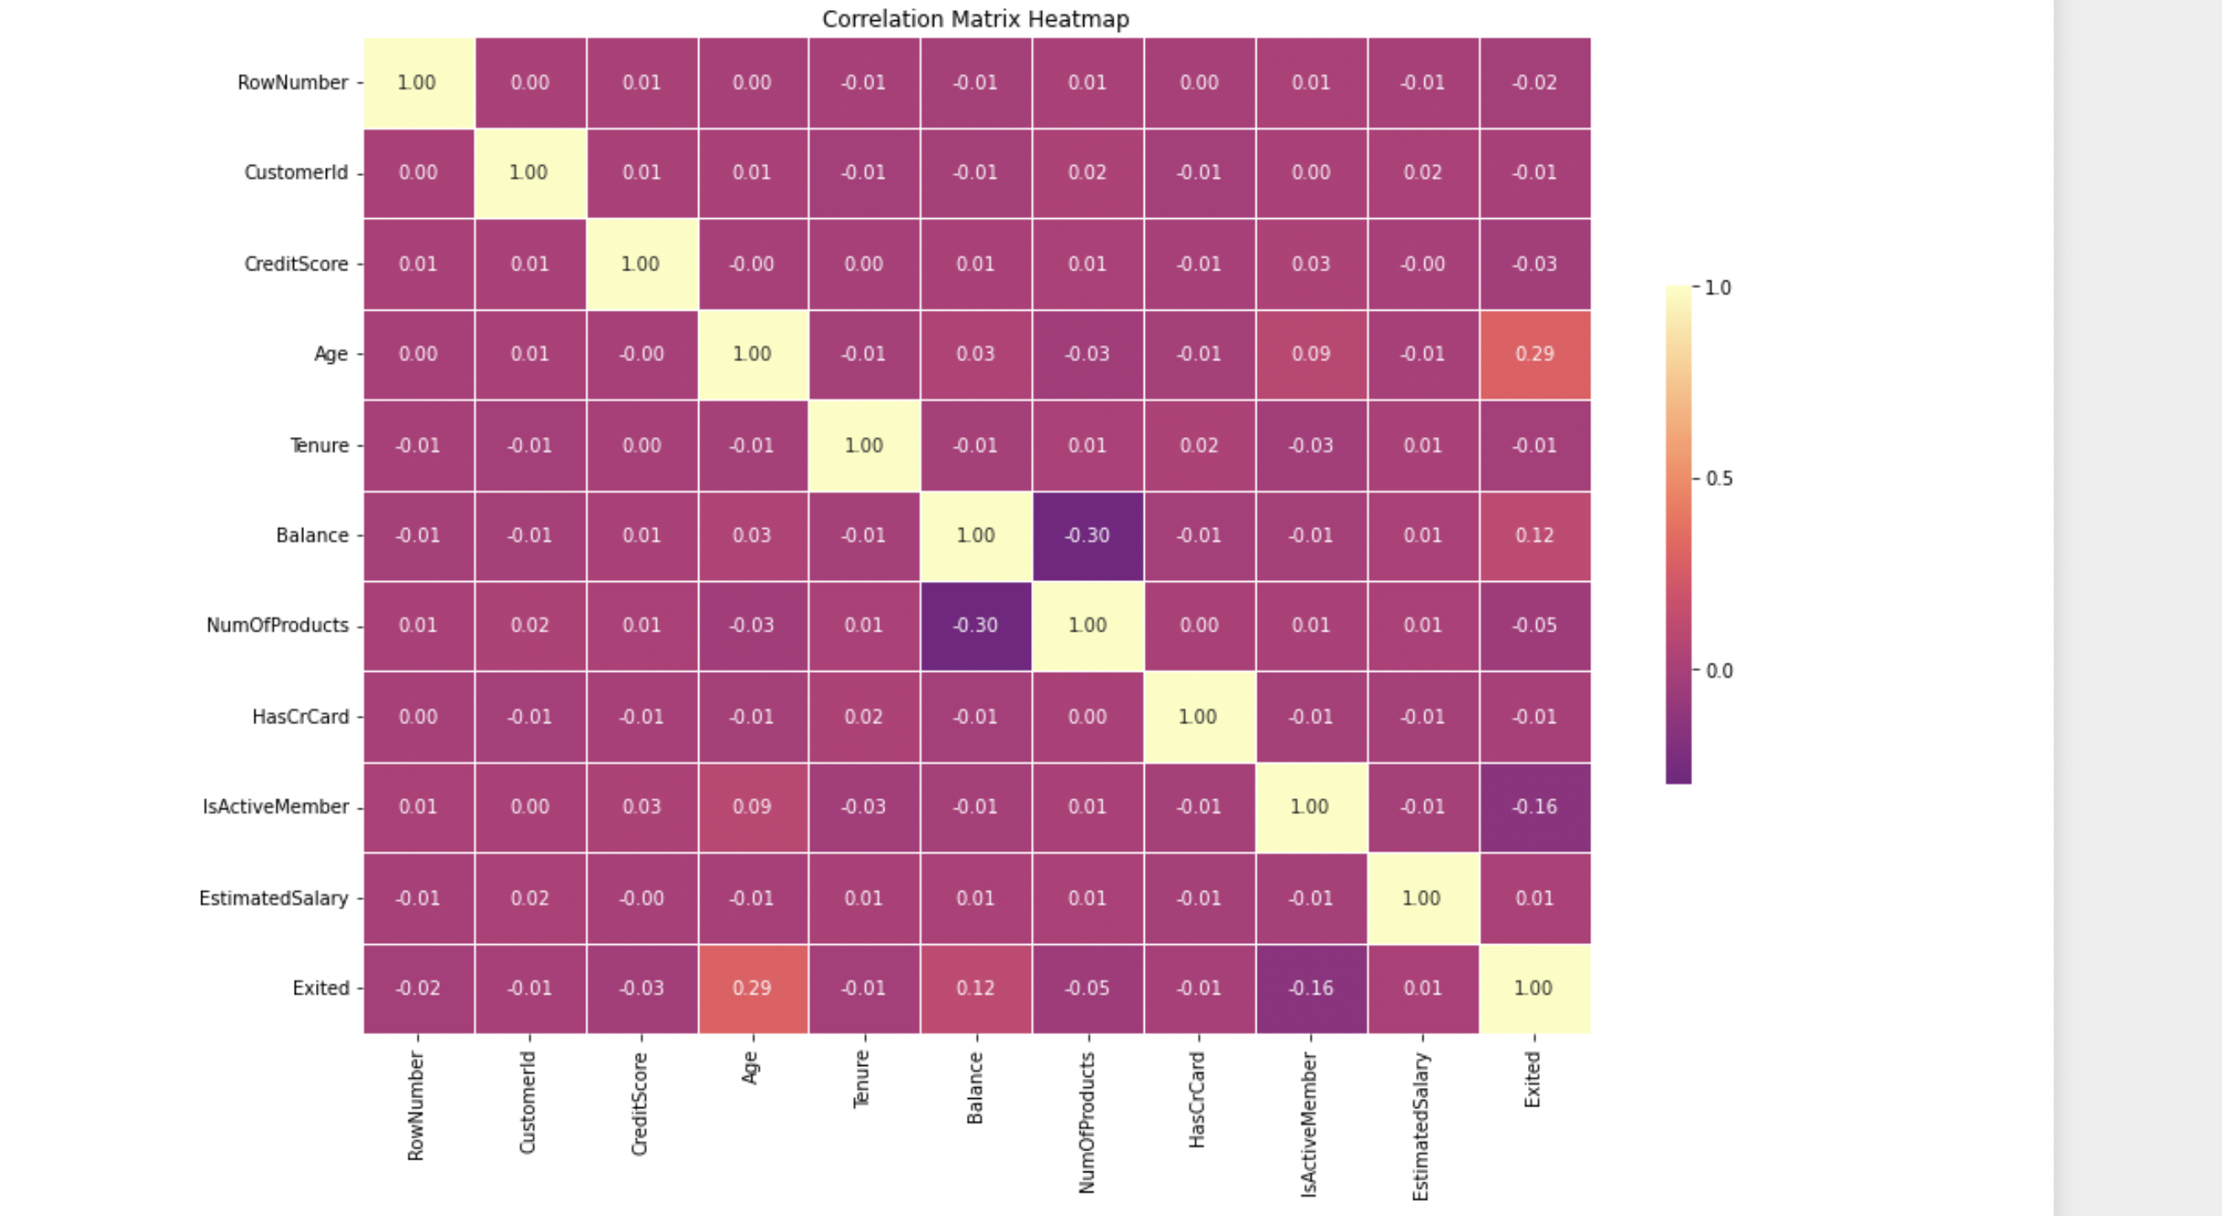
EDA
Heatmaps are frequently used to represent the relationship between different variables in a dataset. I have used three different cmaps.
1) Viridis
2) Plasma
3) Magma
Fig: Magma

Slide 11
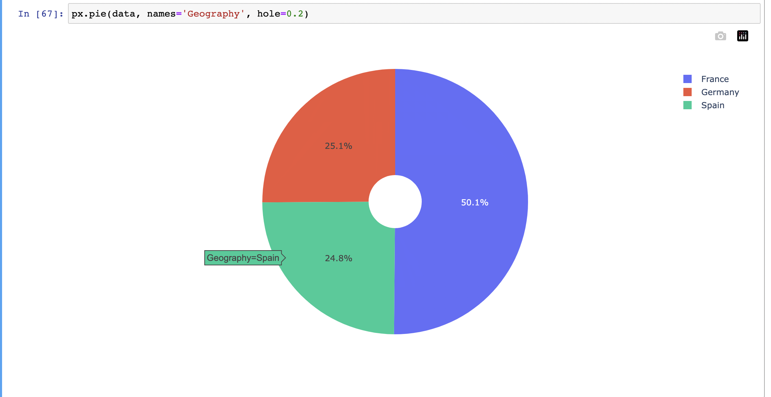
EDA
Insights on the Geography
50.1 customers are from France.
25.1 customers are from Germany
24.8 customers are from Spain.

Slide 12
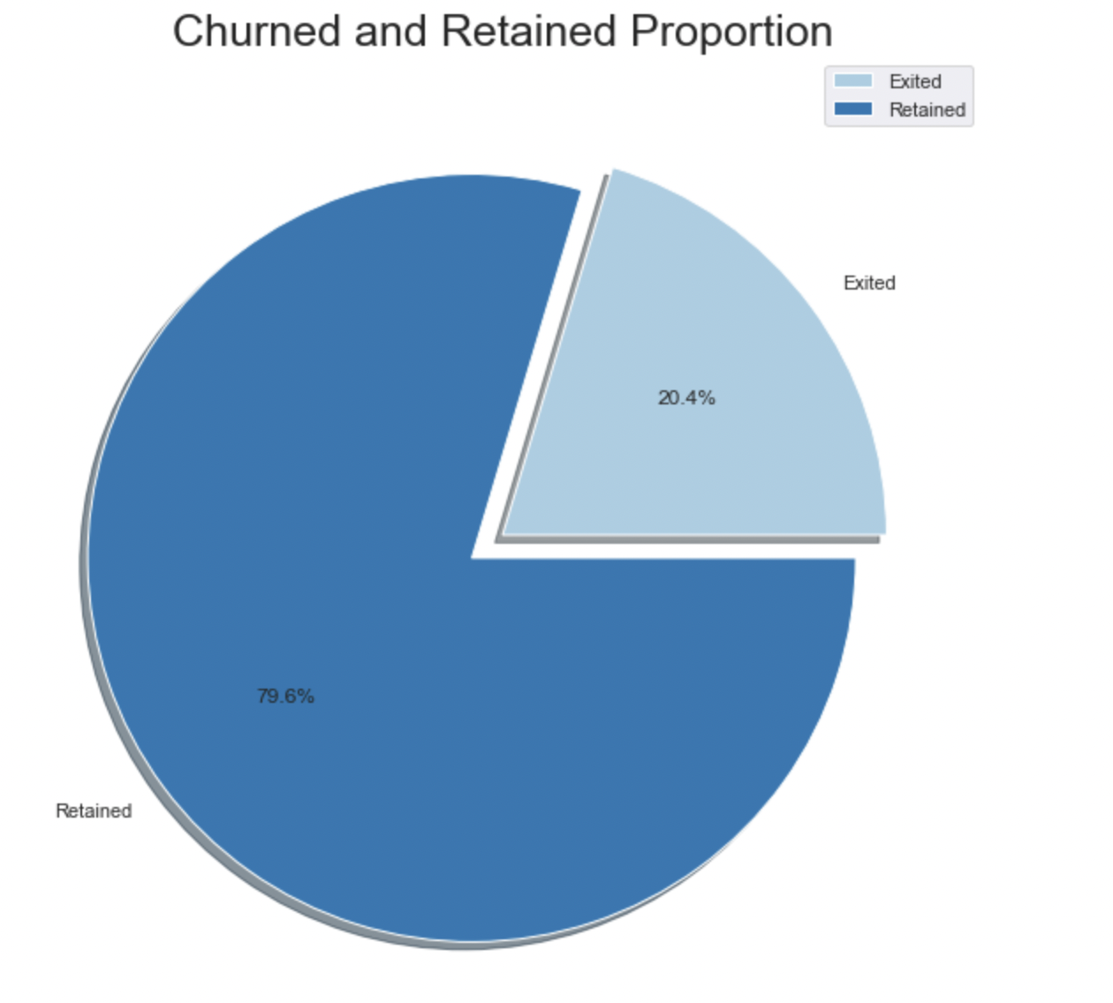
EDA
Churned and Retained Proportion
79.6% customers are retained.
20.4% customers are Exited from the bank.

Slide 13
About the models….
We tested five popular models on the data set: Logistic regression, Decision Tree, Random Forest, XGBoost, and KNN.
Each model has its strengths and weaknesses, and the best model will depend on the specific requirements of the task.
Logistic regression is a popular linear classification algorithm that models the probability of a binary outcome based on a linear combination of input features
Decision Tree is a non-parametric tree-based algorithm that partitions the feature space into regions based on a hierarchy of if-then-else questions
Random Forest is an ensemble learning method that combines multiple decision trees, each trained on a subset of the input features and a bootstrap sample of the data .
XGBoost is a machine learning model that can handle large data sets with multiple features and have achieved better performance in many tasks.
KNN is a simple, supervised machine learning algorithm that can be used to solve both classification and regression problems

Slide 14
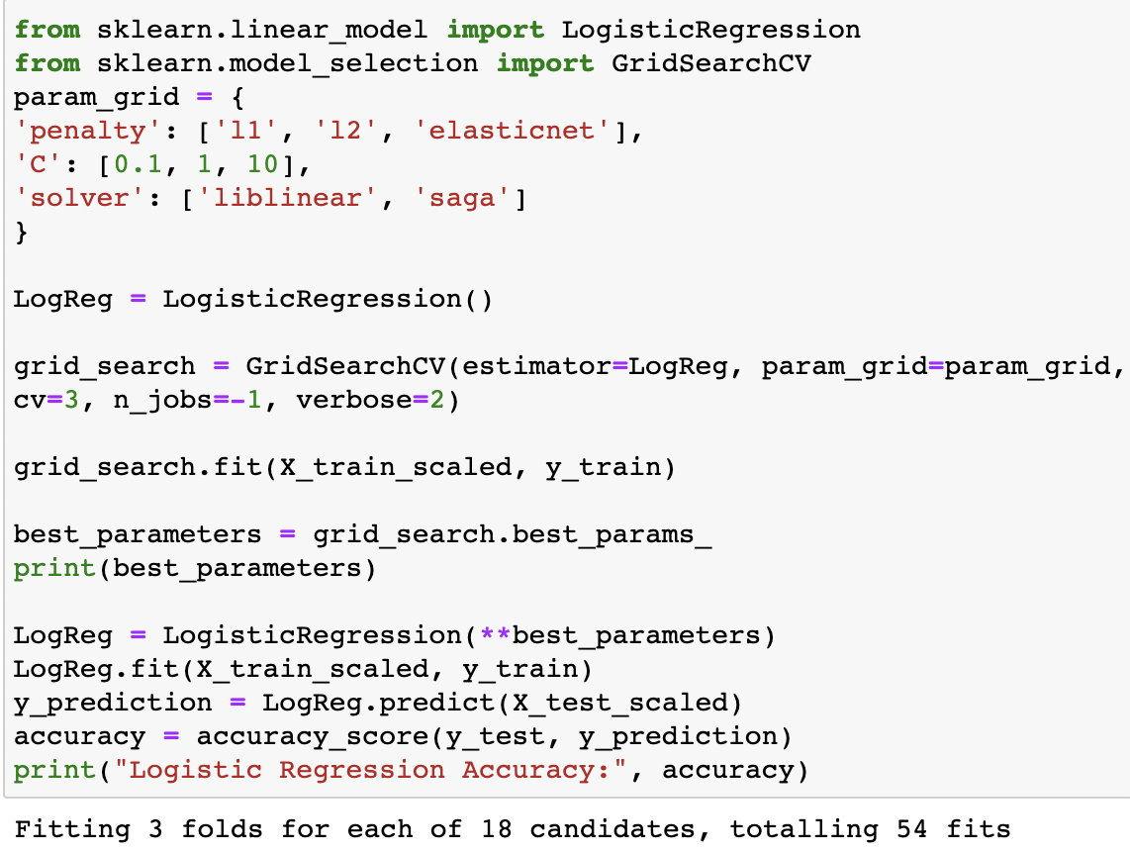
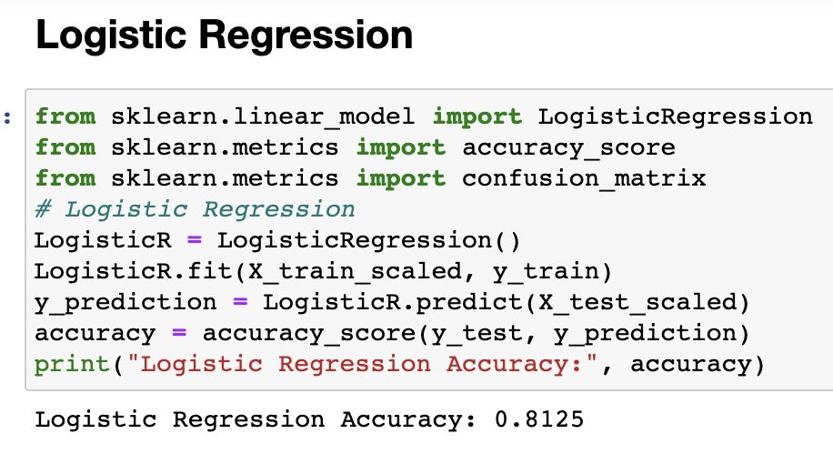
Logistic Regression
Logistic Regression Accuracy with Hyperparameter tuning
Logistic Regression Accuracy without hyperparameter tuning

Slide 15
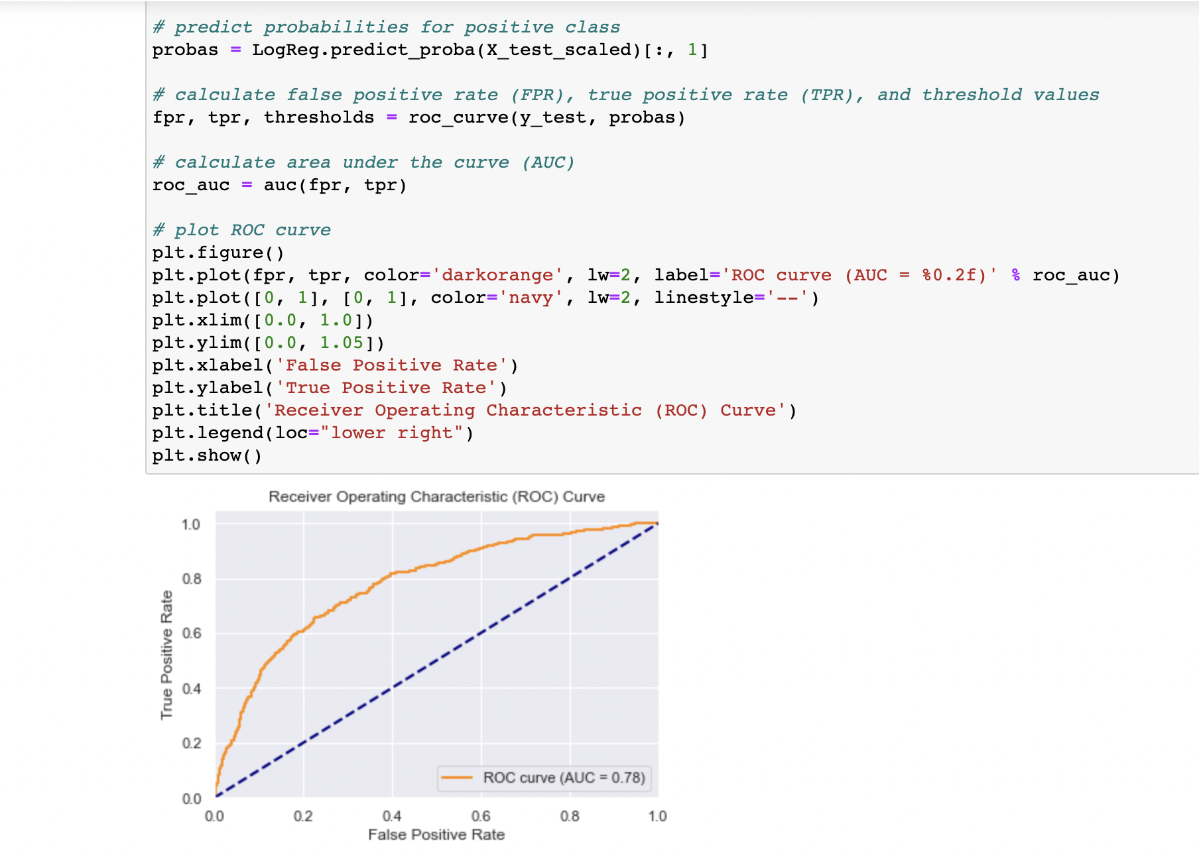
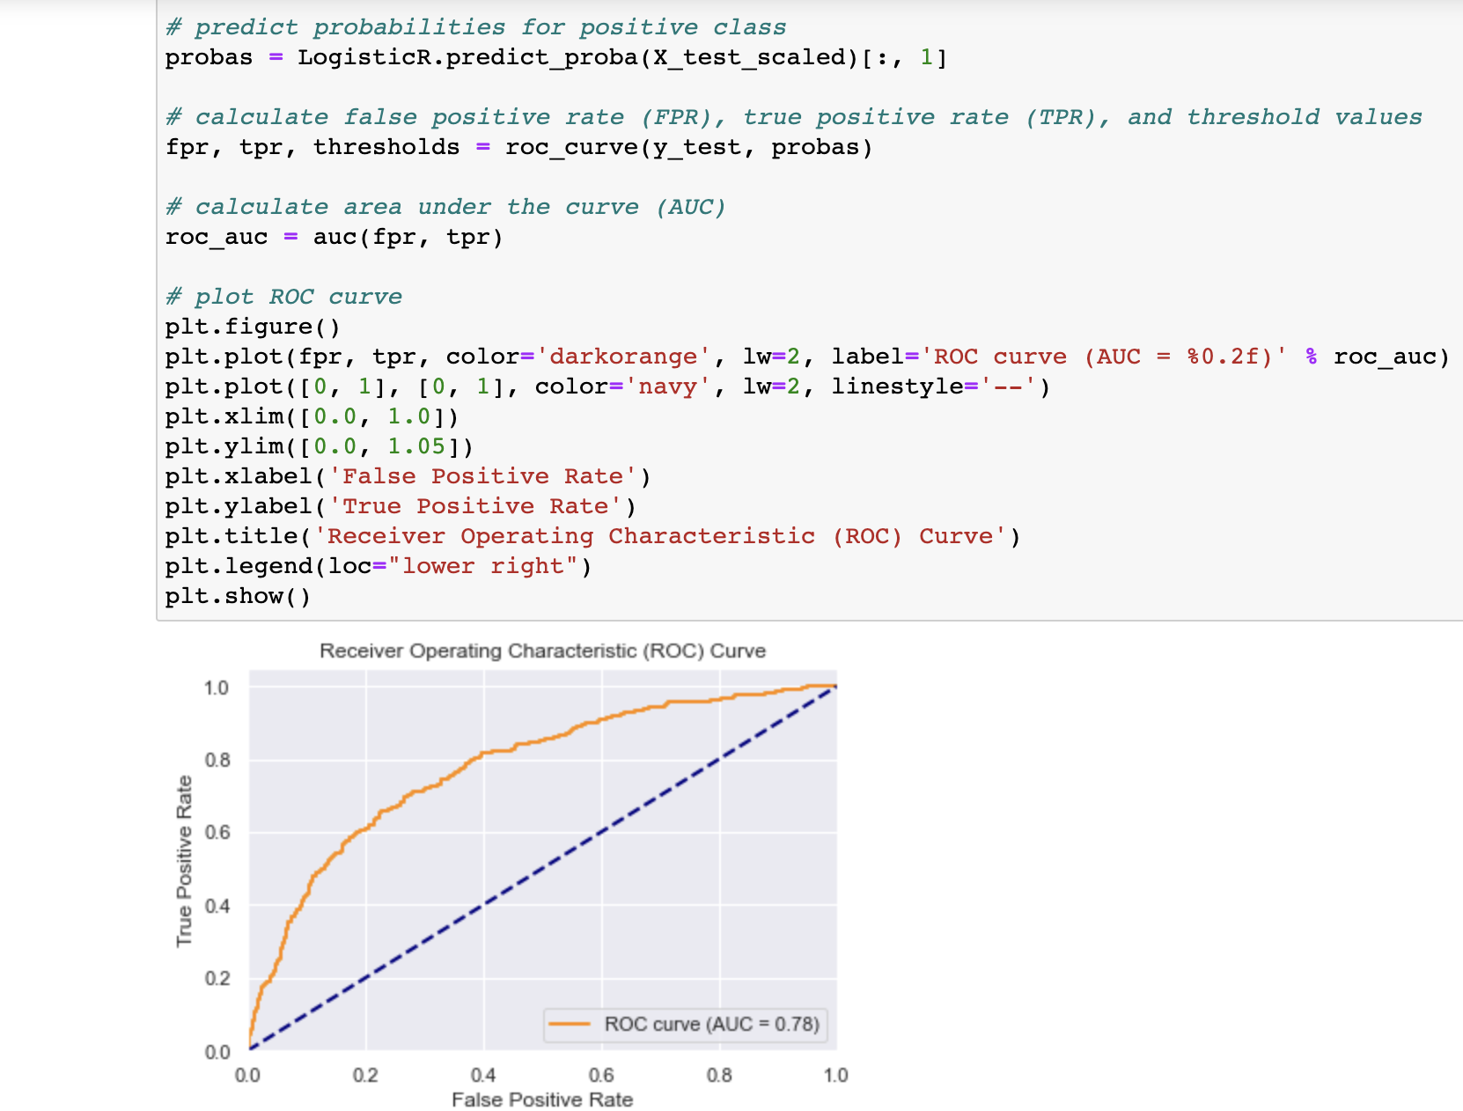
Logistic Regression
Logistic Regression Roc Curve and AUC score with Hyperparameter tuning
Logistic Regression ROC Curve and AUC score without hyperparameter tuning

Slide 16
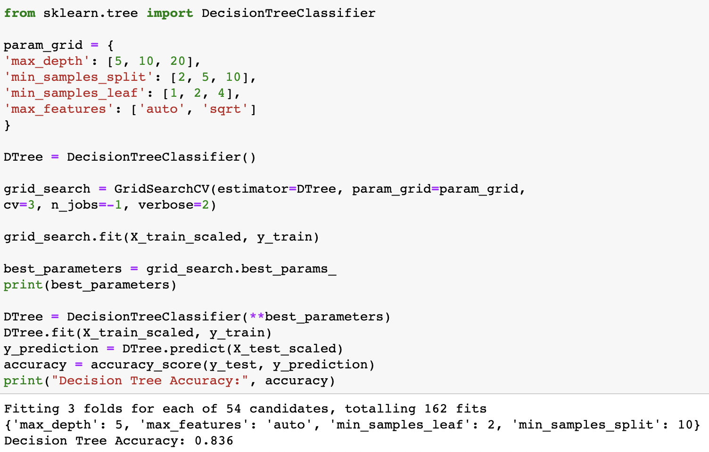
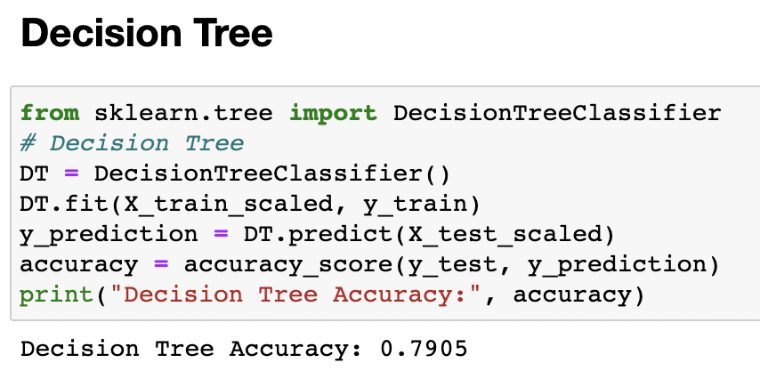
Decision Tree
Decision Tree Accuracy with Hyperparameter tuning
Decision Tree Accuracy without hyperparameter tuning

Slide 17
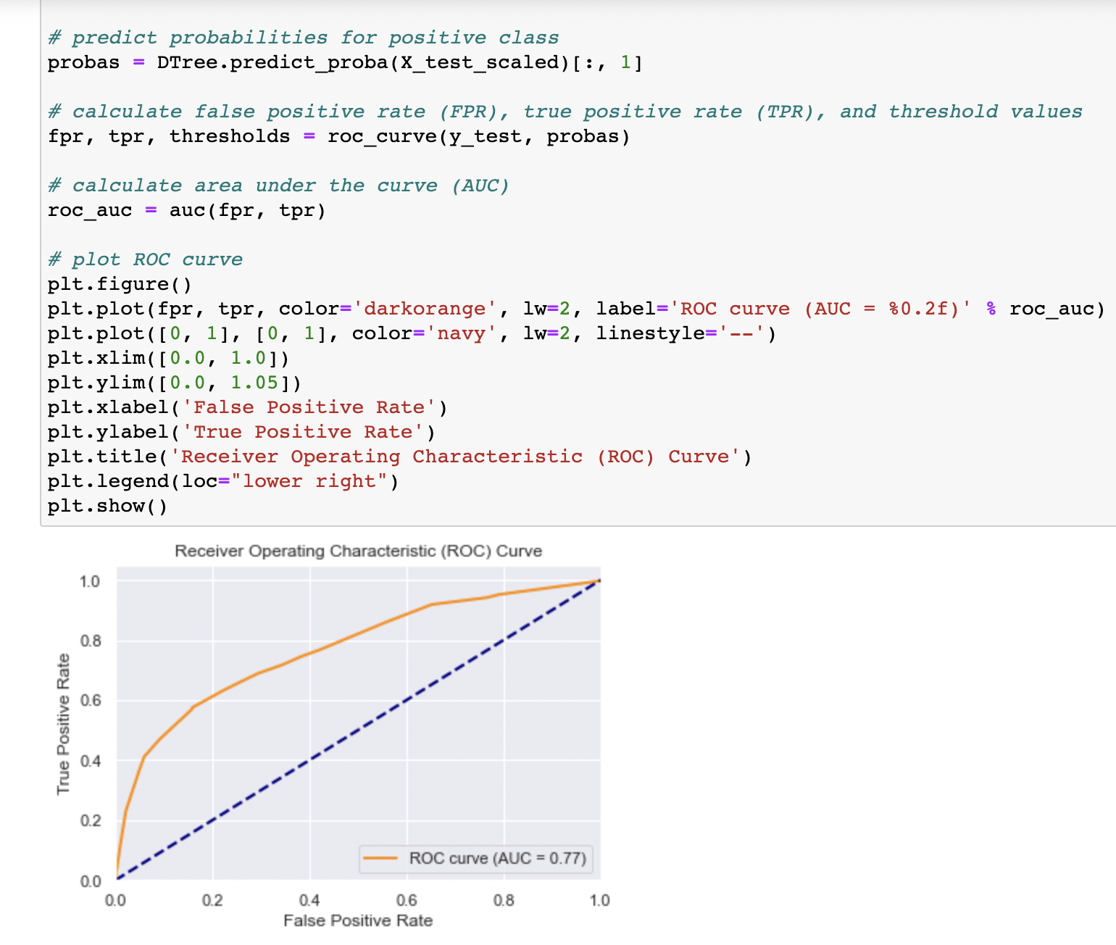
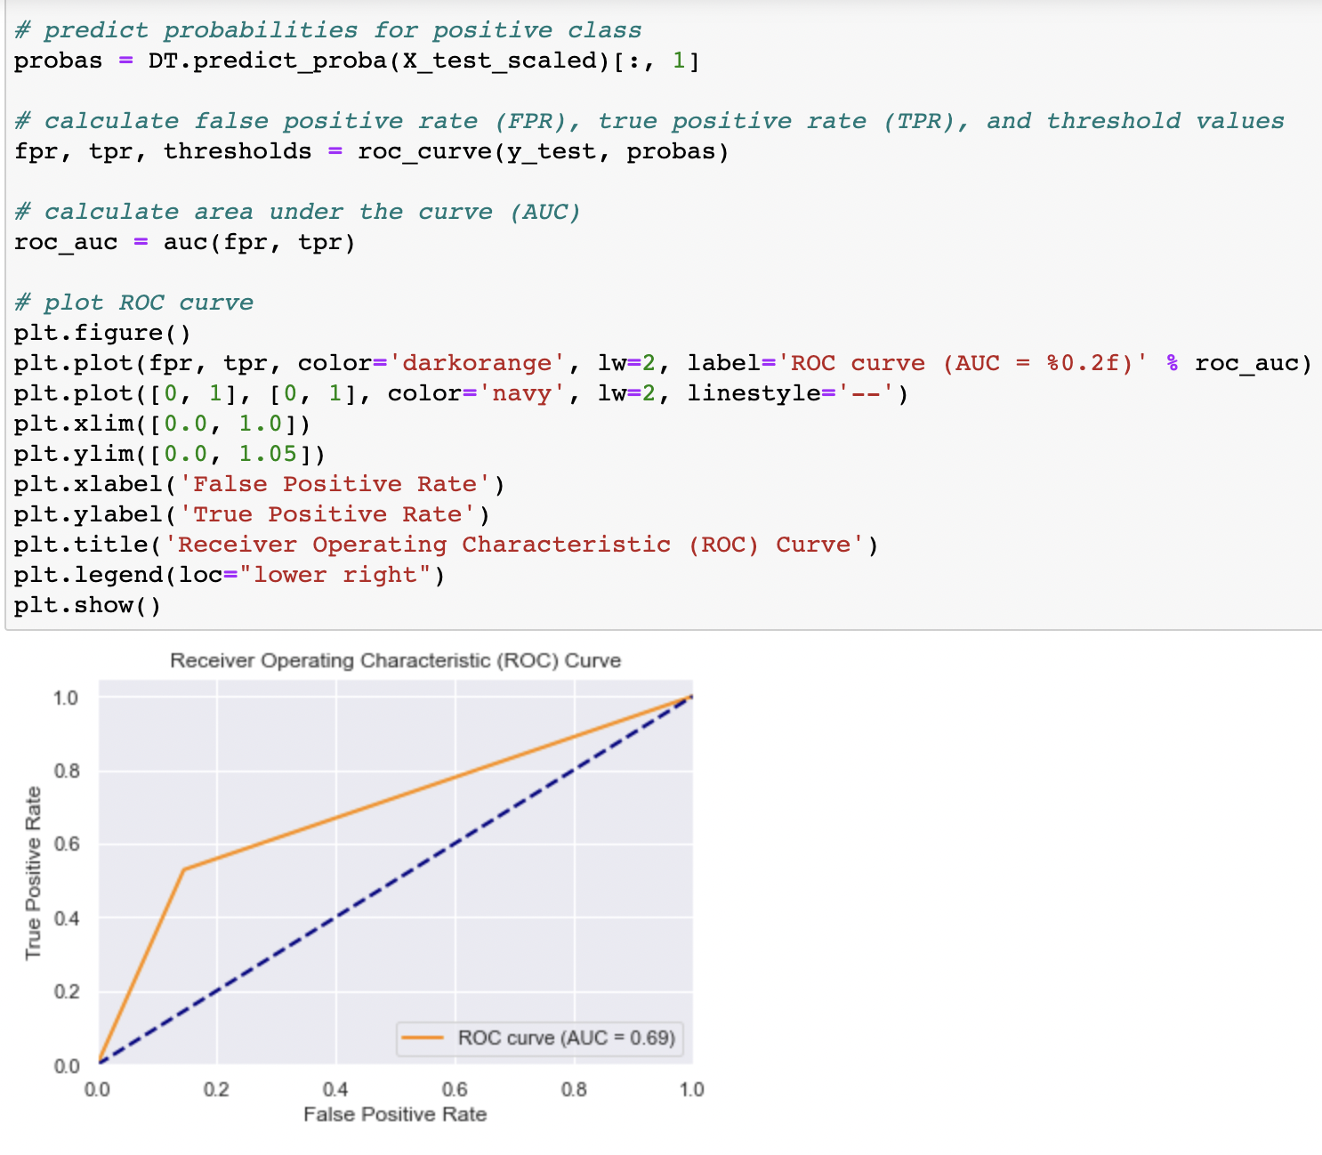
Decision Tree
Decision Tree Roc Curve and AUC score with Hyperparameter tuning
Decision Tree ROC Curve and AUC score without hyperparameter tuning

Slide 18
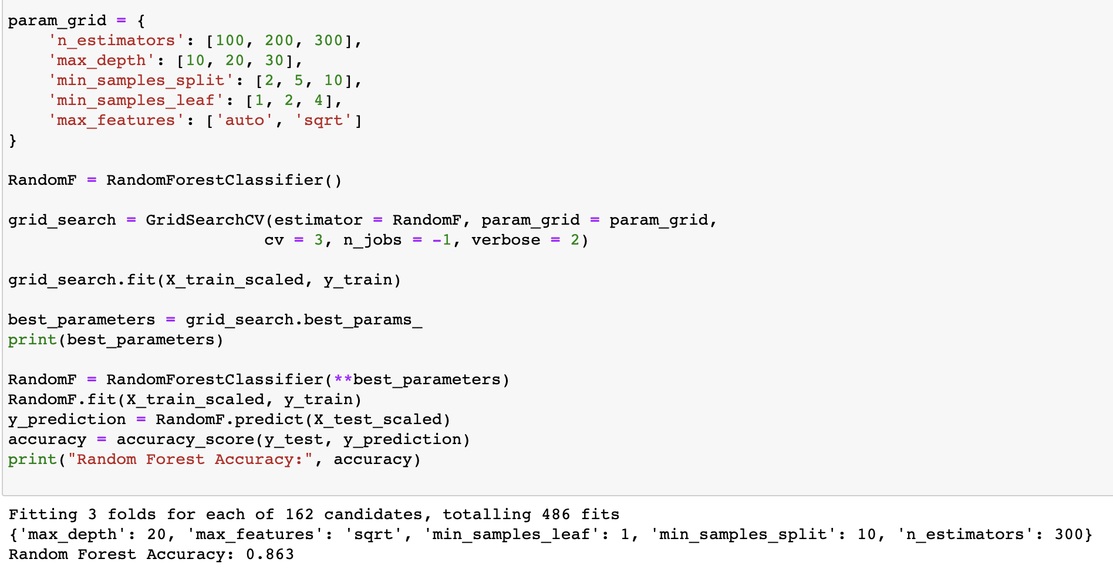
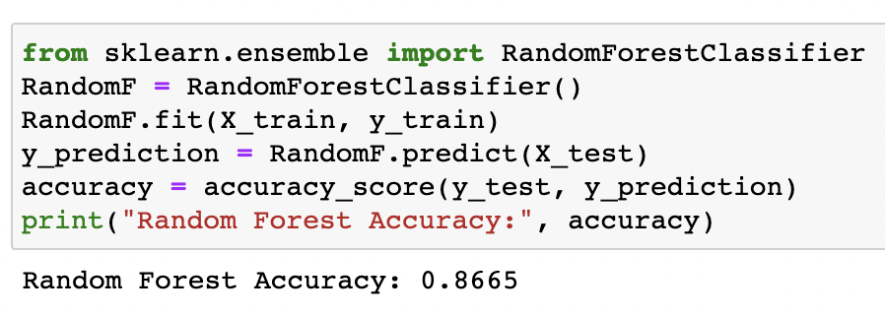
Random Forest
Random Forest Accuracy with Hyperparameter tuning
Random Forest Accuracy without hyperparameter tuning

Slide 19
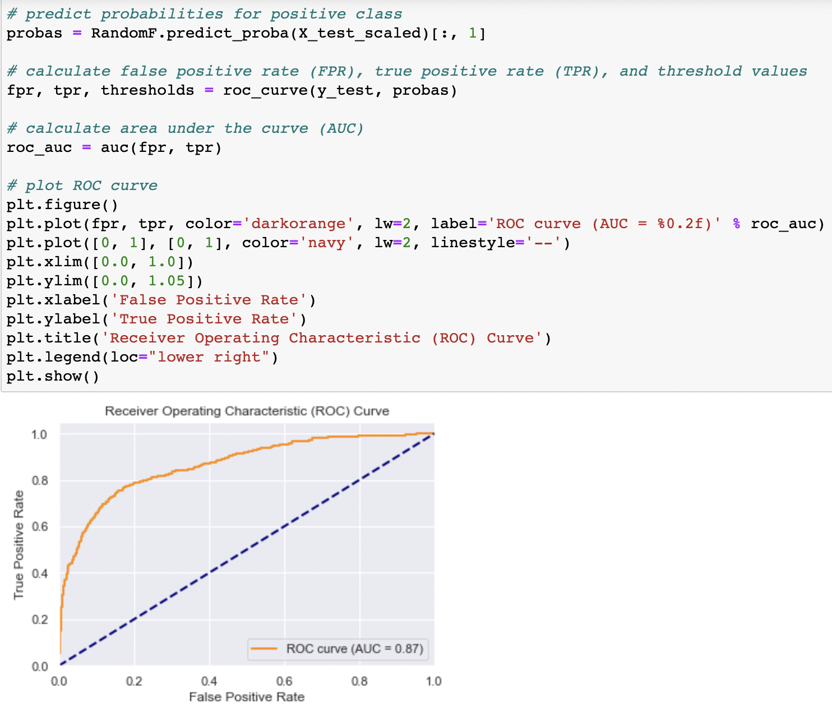
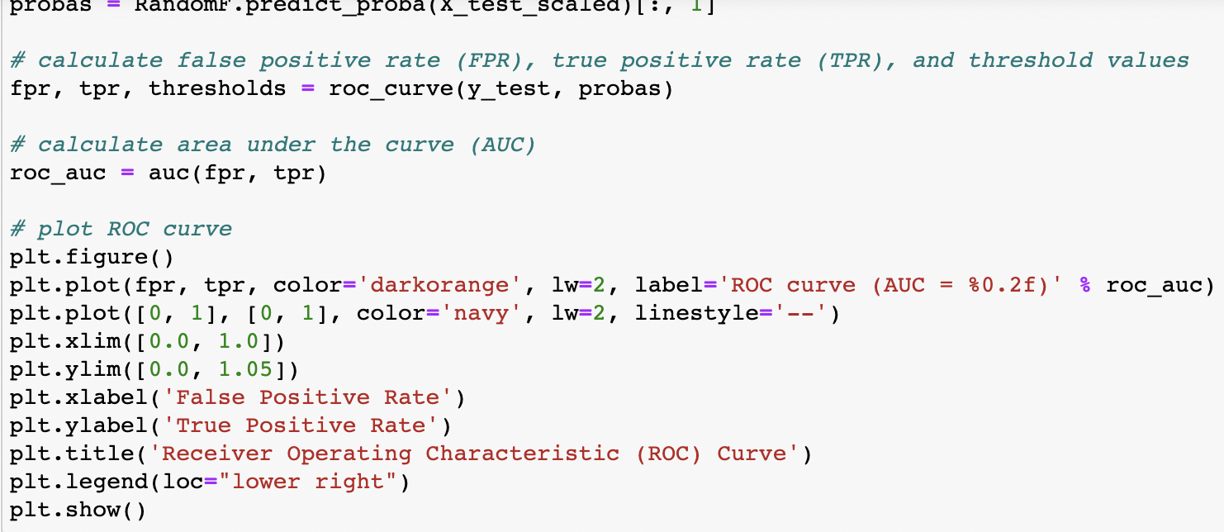
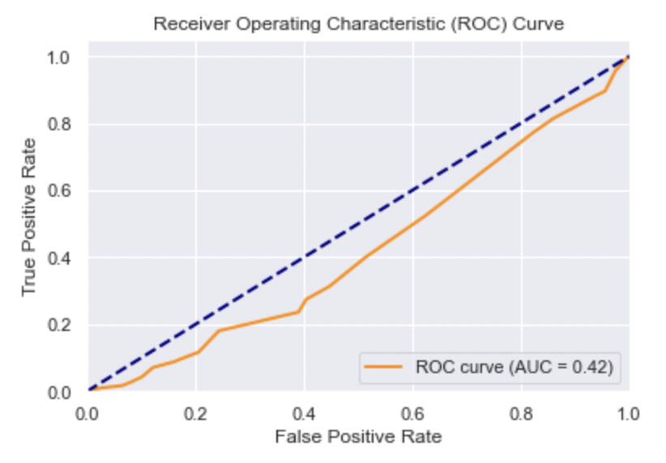
Random Forest
Random Forest Roc Curve and AUC score with Hyperparameter tuning
Random Forest ROC Curve and AUC score without hyperparameter tuning

Slide 20
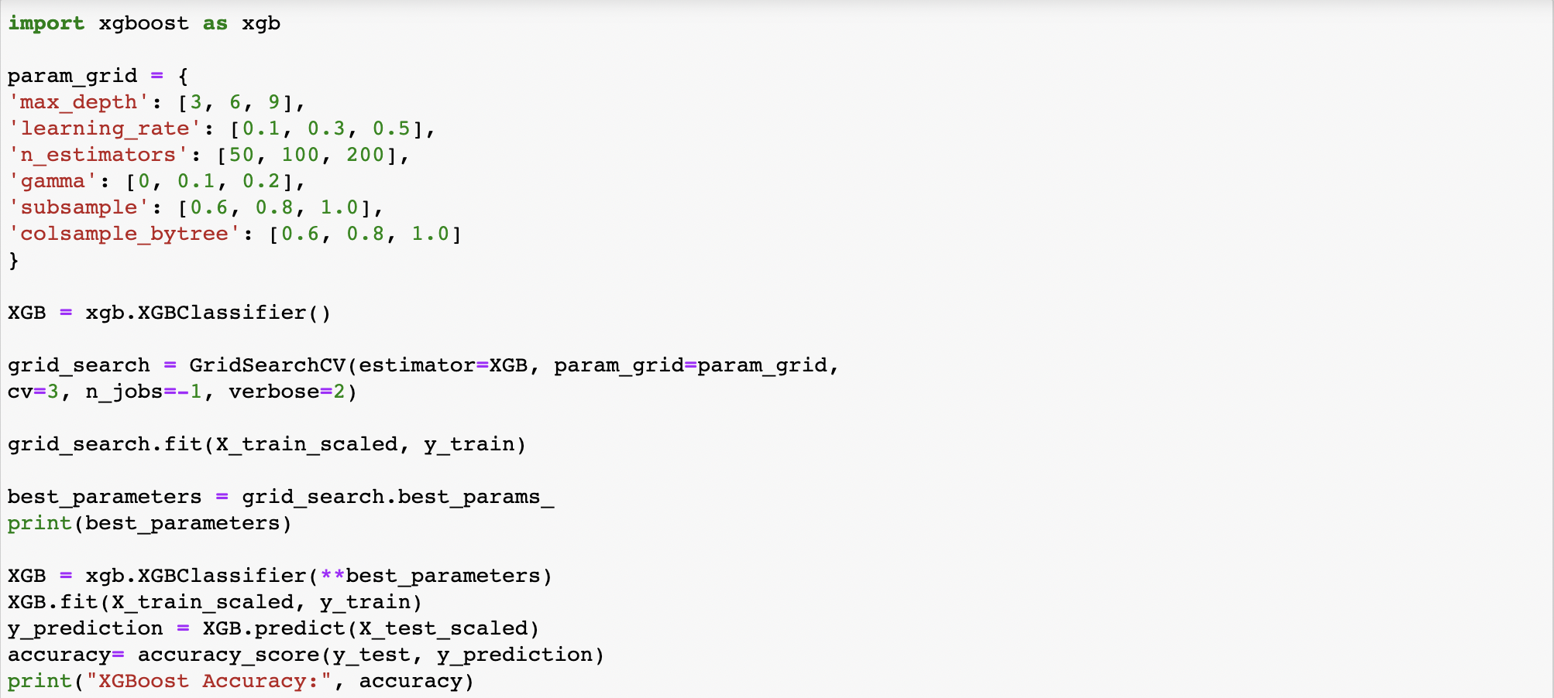
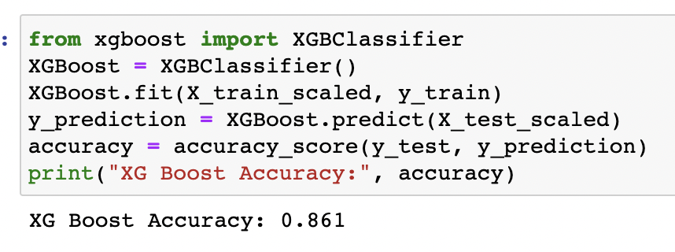
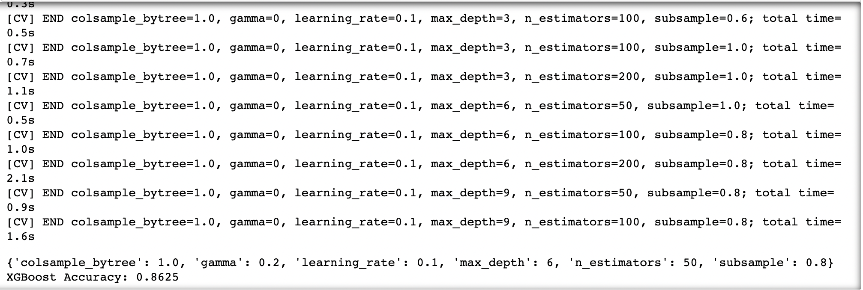
XGBoost
XGBoost Accuracy without hyperparameter tuning
XGBoost Accuracy with Hyperparameter tuning

Slide 21
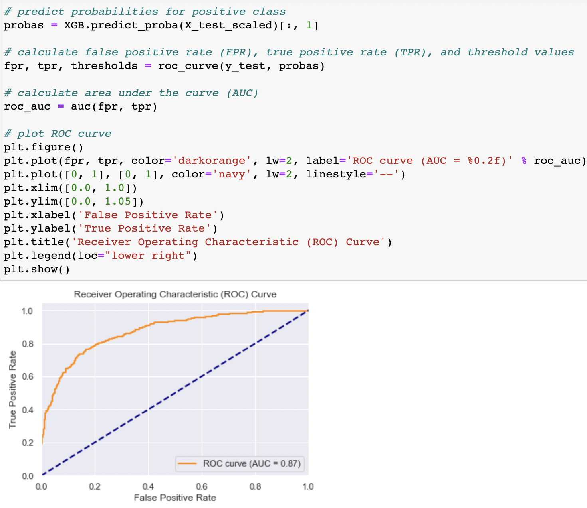

XGBoost
XGBoost Roc Curve and AUC score with Hyperparameter tuning
XGBoost ROC Curve and AUC score without hyperparameter tuning

Slide 22
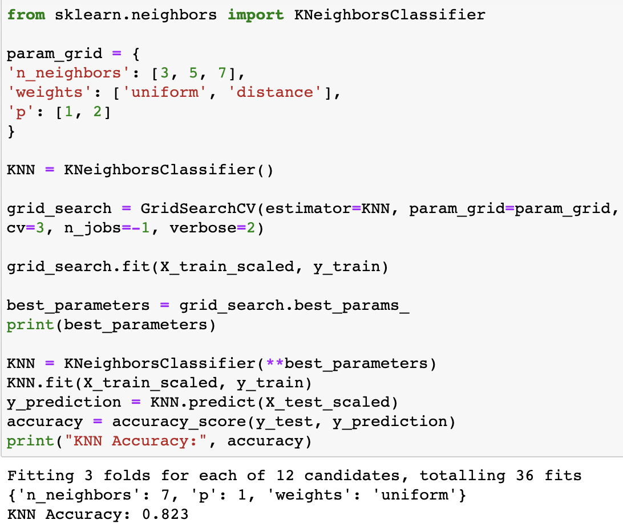
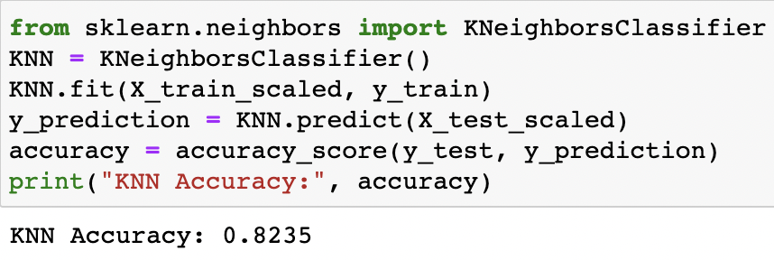
KNN
KNN Accuracy with Hyperparameter tuning
KNN Accuracy without hyperparameter tuning

Slide 23
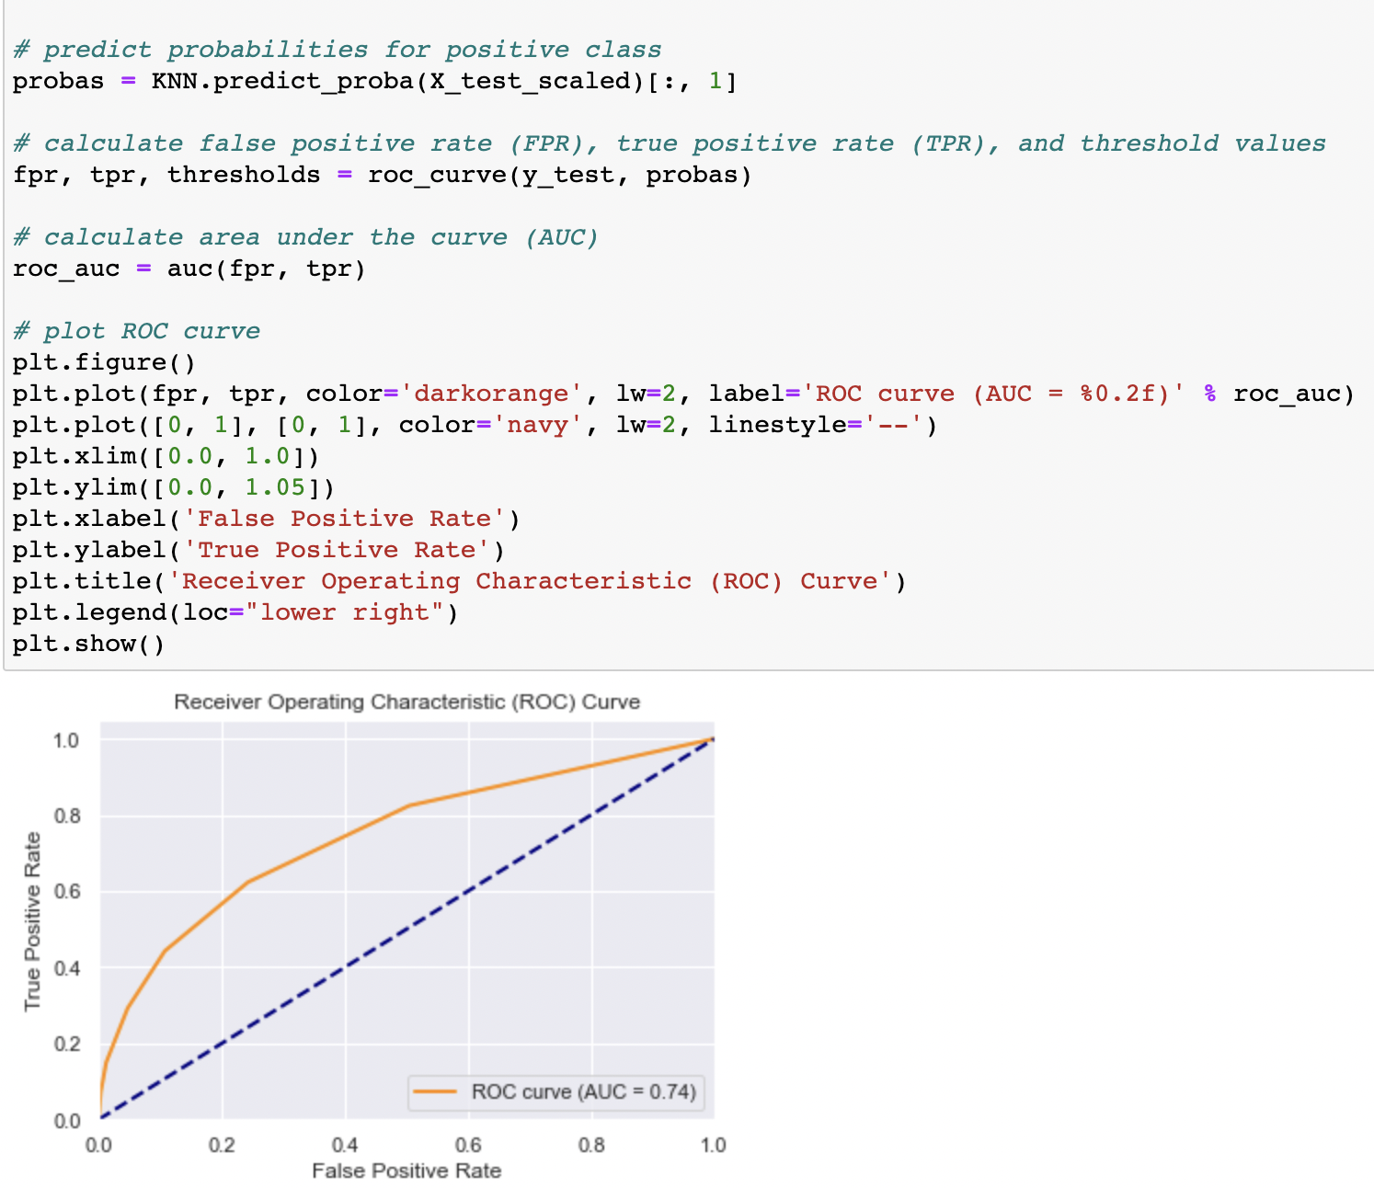
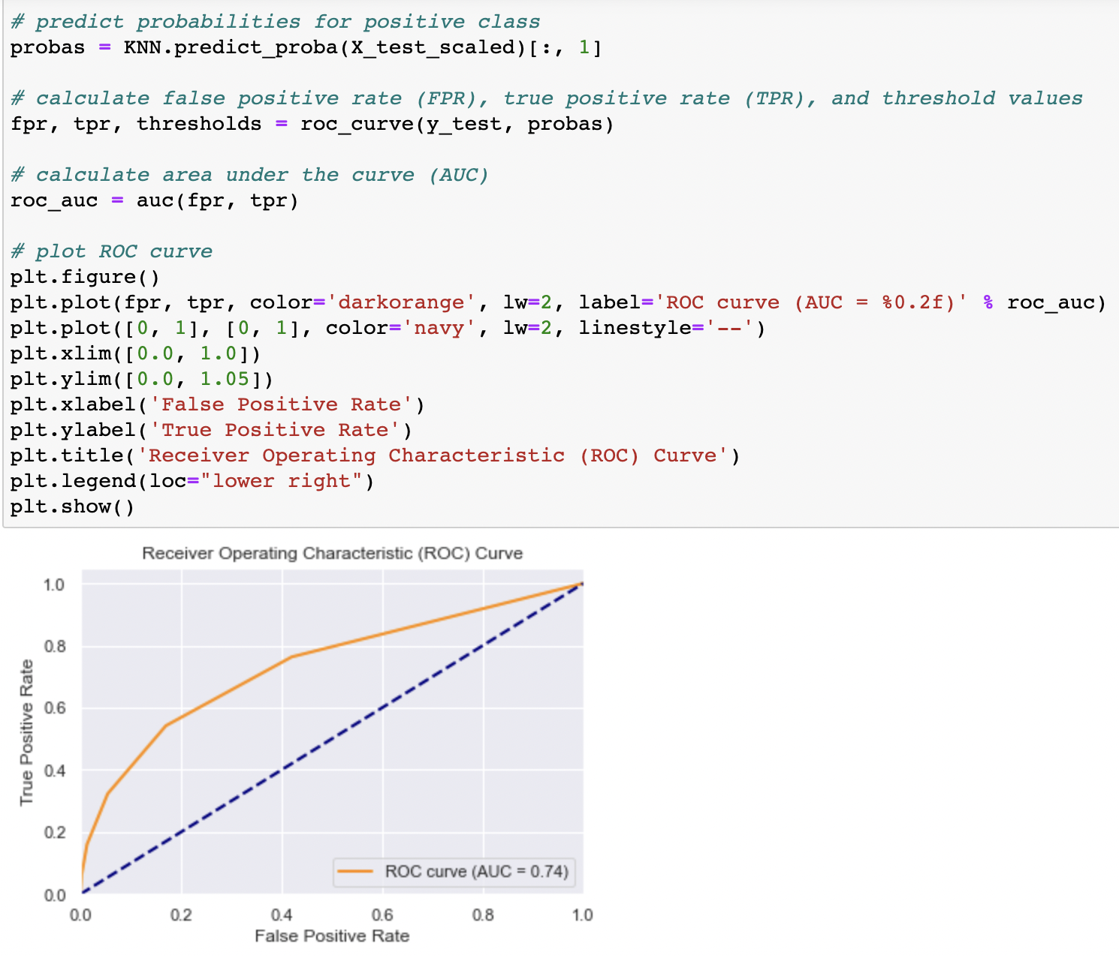
KNN
KNN ROC Curve and AUC score without hyperparameter tuning
KNN Roc Curve and AUC score with Hyperparameter tuning

Slide 24
Results- Which model performed better?
Models | Accuracy | AUC Score | Accuracy with Hyperparameter Tuning | AUC Score
Logistic Regression | 0.8125 | 0.78 | 0.811 | 0.78
Decision Tree | 0.7905 | 0.69 | 0.836 | 0.77
Random Forest | 0.8665 | 0.42 | 0.863 | 0.87
XGBOOST | 0.861 | 0.85 | 0.8625 | 0.87
KNN | 0.8235 | 0.74 | 0.823 | 0.74

Slide 25
References
https://www.google.com/url?sa=i&url=https%3A%2F%2Fwww.kaggle.com%2Fcode%2Fkmalit%2Fbank-customer-churn-prediction&psig=AOvVaw0F6Ky6qnXKnhDI7xArFYgg&ust=1682569374024000&source=images&cd=vfe&ved=0CBAQjRxqFwoTCKDi78DZxv4CFQAAAAAdAAAAABAF
https://www.kaggle.com/datasets/mathchi/churn-for-bank-customers?resource=download
https://www.akkio.com/post/bank-churn-prediction#:~:text=Bank%20customer%20churn%20prediction%20is,numerical%20(the%20churn%20rate).

Slide 26
Thank You

